Slide 1
Death Rates, Pharmaceutical Sales, and Pfizer Stock: A Correlational Analysis
AI Boot Camp Project 1
Team Members:
Rebecca Carr
Ronak Dsouza
Jesse Gunter
Tanya Soriano

Slide 2
Project Overview
Project Purpose / Description
This research aims to explore the potential interconnections between death rates in the United States and two key variables: pharmaceutical sales and Pfizer stock prices. By analyzing these variables over time, we seek to identify any correlations or patterns that may suggest relationships between public health outcomes, medical technology trends, and pharmaceutical industry performance.

Slide 3
Project Overview
Goals/Questions to be addressed
Determine if U.S. death rates correlate with drug sales.
Determine if U.S. death rates correlate with Pfizer stock closing price.
Are there seasonal patterns in drug sales, death rates and Pfizer stock?
Determine best time of year to buy Pfizer stock.

Slide 4
Project Overview
Overview of data collection, cleanup and exploration process
Data was obtained from reliable sources. Death rate statistics were sourced from the Centers for Disease Control and Prevention (CDC), a leading public health agency. Pharmaceutical sales data was acquired from Kaggle, a trusted platform for data scientists. Historical Pfizer stock prices were retrieved from Marketwatch, a prominent financial news and data provider.
We initiated the data cleaning process by thoroughly examining the datasets. We focused on 3 datasets:
1. Death rates in the United States
2. Pharmaceutical sales data
3. Pfizer stock prices

Slide 5
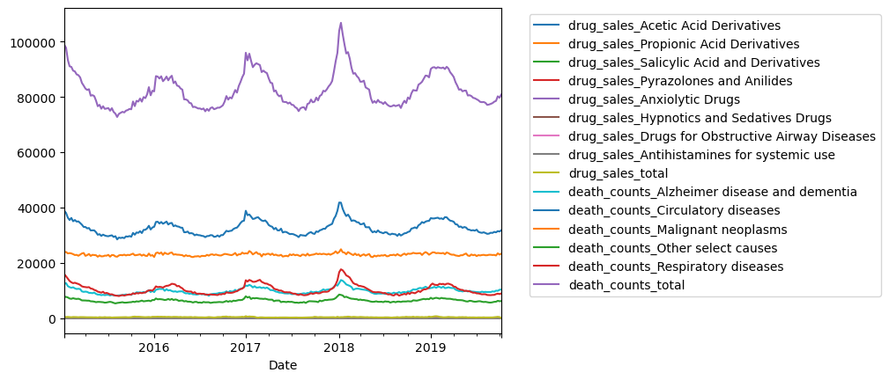
EXAMPLE PRELIMINARY DATA VISUALIZATION
All Drug Sales and All Death Count Categories

Slide 6
Approach taken to achieve goals
Project Overview
Data Consistency and Standardization
Standardized date/time formats to ensure data consistency and facilitate merging.
Data Cleaning
Removed missing values, addressed duplicates, and resolved data type inconsistencies.
Renamed columns for clarity.
Data Grouping and Preparation
Grouped data using groupby (e.g., by disease types) for more insightful analysis.
Merging and Correlation Analysis
Merged data frames to explore correlations.
Used corr function to compute Pearson correlation coefficients.
Data Visualization and Trends
Generated visualizations using plot to identify seasonal trends.

Slide 7
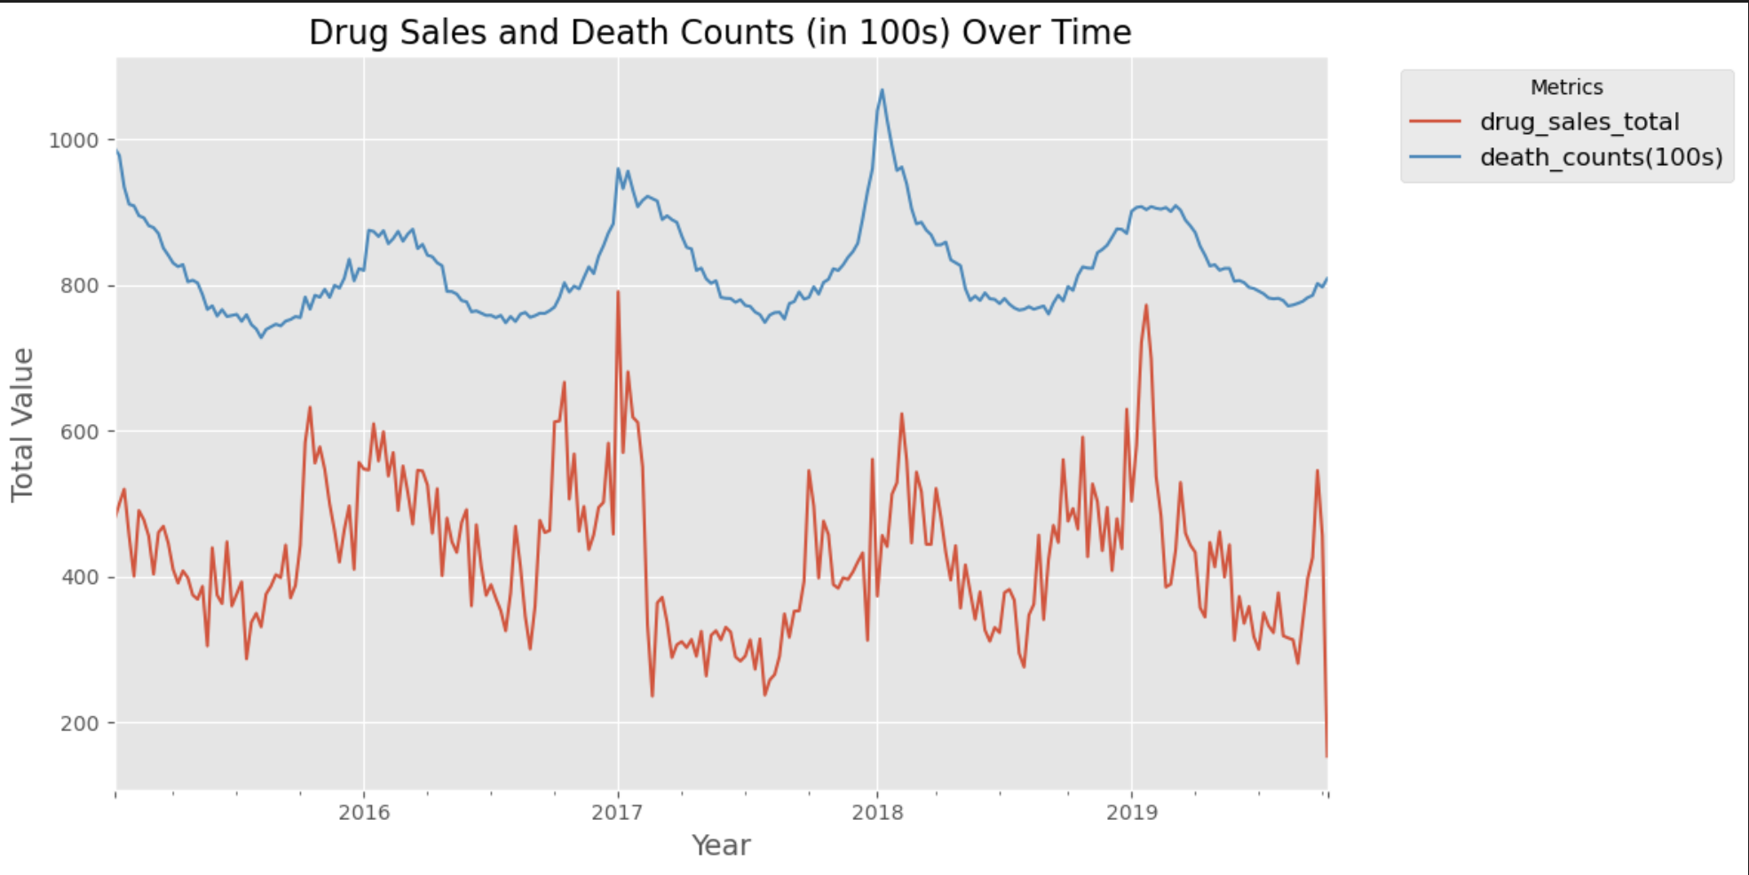
Correlation between total drug sales and total death counts. Correlation coefficient of 0.423
Result/Conclusion 1

Slide 8
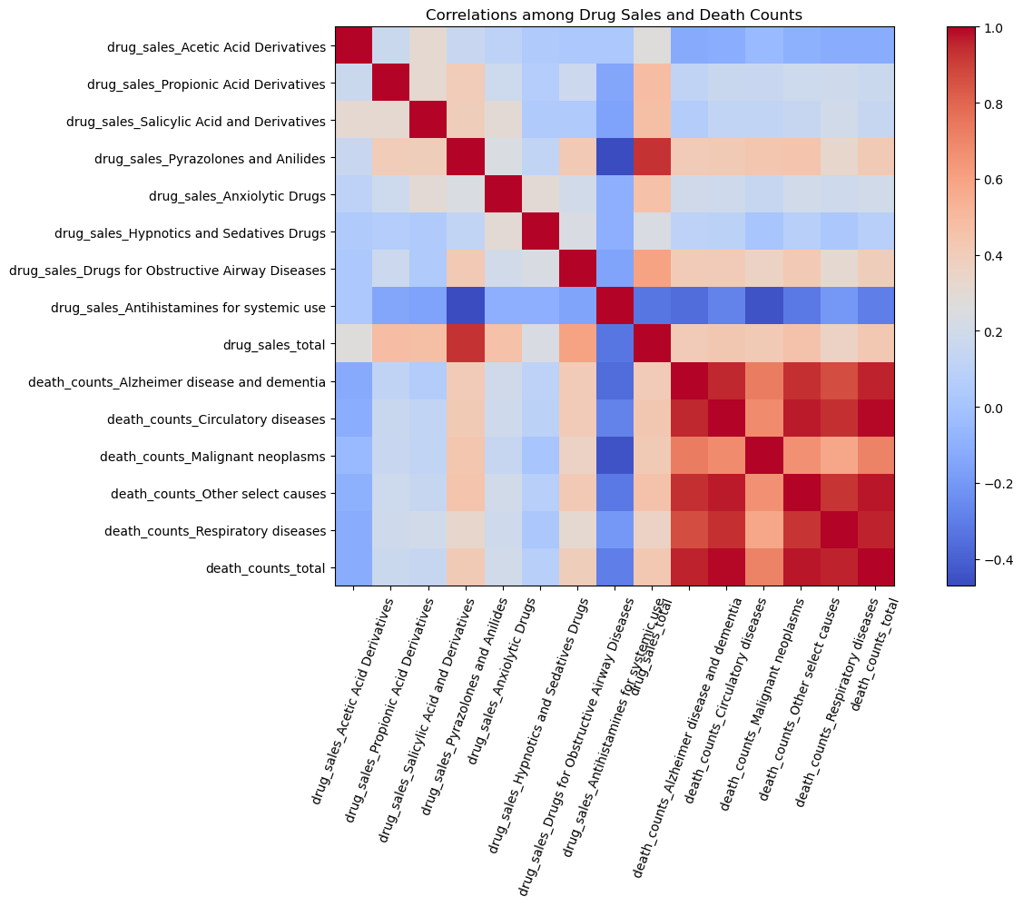
Result/Conclusion 1

Slide 9
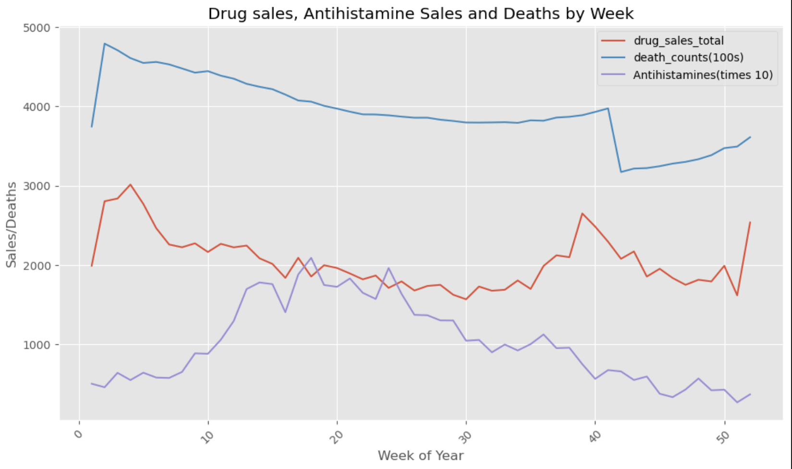
Overall drug sales and death counts seem to seasonally be higher in the winter. Antihistamines are an exception and are higher in the spring/summer.
Result/Conclusion 2

Slide 10
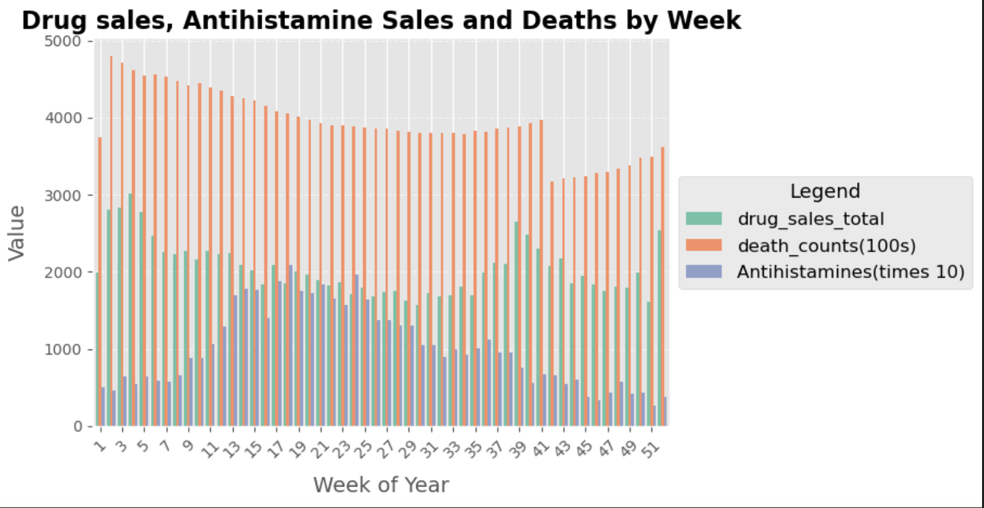
Result/Conclusion 2

Slide 11
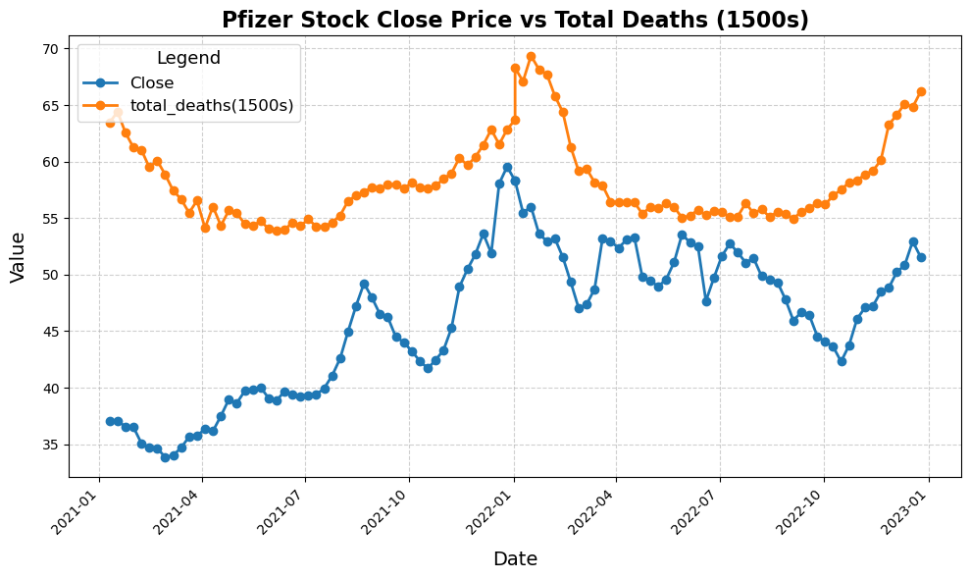
Correlation between Pfizer closing price and total death rates. Correlation coefficient of .384
Result/Conclusion 3

Slide 12
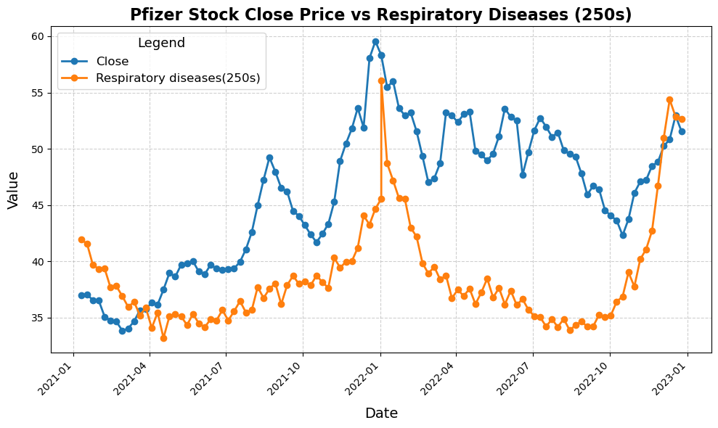
Correlation between Pfizer closing price and respiratory death rates. Correlation coefficient of .464
Result/Conclusion 3

Slide 13
Key Insights:
There is a positive correlation between death rates and drug sales: when death rates increase, pharmaceutical sales increase.
Death rates are higher in winter, and therefore, so are pharmaceutical sale. However, the data suggests antihistamines are an exception. This could be due to summer allergies.
There is a positive correlation between death rates and Pfizer stock prices. The correlation coefficient increases when filtered to respiratory diseases.
Implications:
Better to buy Pfizer in the summer and sell in the winter.
Pharmaceutical companies should optimize manufacturing and logistics timelines for maximum profitability.
Summary

Slide 14
Problems Encountered
Sourcing data with the necessary details was difficult, as many sources used excessive medical terminology.
Some data did not have enough documentation.
Trouble finding data that matched timeframe?
What code to use to produce the best result.
Working with GitHub and multiple branches.

Slide 15
Future Considerations
Performing this same study but with longer timeframes of data to detect patterns and trends.
Lining up all 3 datasets.
Exploring post-COVID-19 pandemic deaths that are not directly attributed to COVID.
Additional tools when working with GitHub and Jupyter such as Nbdime.

